Slide 1
LINE
INDEX NO,LINE,GROUP NO,X1,Y1,Z1,X2,Y2,Z2
HLINE
INDEX NO,HLINE,GROUP NO,X1,Y1,Z1,X2,Y2,Z2,VISIBLE

Slide 2
ARC
INDEX NO,ARC,GROUP NO,
ORIGIN X,ORIGIN Y,ORIGIN Z,
START X,START Y,START Z,
SWEEP ANGLE IN DEGREE,
NORMAL VECTOR X,NORMAL VECTOR Y,NORMAL VECTOR Z,
RATIO(optional)

Slide 3
ELLIPSE
INDEX NO,ELLIPSE,GROUP NO,
ORIGIN X,ORIGIN Y,ORIGIN Z,
AXIS1,AXIS2,
NORMAL VECTOR X,NORMAL VECTOR Y,NORMAL VECTOR Z,
Start Angle , Sweep Angle,
Rotation Matrix(3x3)

Slide 4
LOOP=
{ //! Start of loop
  CREATION=SOLID/HOLE //! Solid or hole
  LINE,HLINE,ARC,3D_FACE,ELLIPSE element //! Refer to LINE,HLINE,ARC,ELLIPSE,3D_FACE or ARC page
} //! End of loop

Slide 5
EXTR=
{ //! Start of extr
  LOOP= //! Loop element(refer to ‘LOOP=‘ page)
  HEIGHT=5 //! Extrusion height
  AXIS=DX,DY,DZ //! Extrusion vector
} //! End of extr

Slide 6
PLANESURF=
{ //! Start of planesurf
  LOOP= //! Plane surface boundaries (series of LOOP= element)
  LOOP=
  …
} //! End of planesurf

Slide 7
REVOSURF=
{ //! Start of revolvedsurf
  LOOP= //! Plane surface boundaries (series of LOOP= element)
  ORIGIN=X,Y,Z
  NORM=DX,DY,DZ
  ROTATE=ANGLE(in degree) //! Rotation angle
} //! End of revolvedsurf

Slide 8
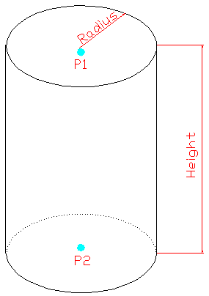
<CYLN>
<CYLN>,RADIUS,
X1,Y1,Z1, //! P1
X2,Y2,Z2 //! P2

Slide 9
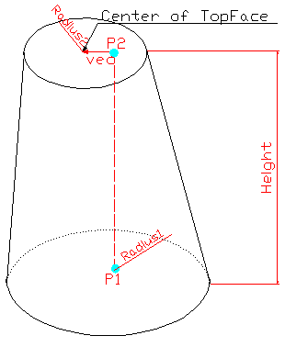
<CONE>
<CONE>,RADIUS1,RADIUS2
X1,Y1,Z1, //! P1
X2,Y2,Z2 //! P2
DX,DY,DZ //! Vec(optional)

Slide 10
<PIPE>
TYPE1
  <PIPE>,RADIUS,X1,Y1,Z1,X2,Y2,Z2
TYPE2
  <PIPE>,
  RADIUS1,X11,Y11,Z11,X12,Y12,Z12,
  RADIUS2,X21,Y21,Z21,X22,Y22,Z22,
  RADIUS3,X31,Y31,Z31,X32,Y32,Z32

Slide 11
<MUPI>
<MUPI>,RADIUS,X1,Y1,Z1,X2,Y2,Z2

Slide 12
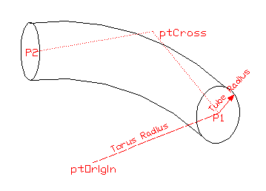
<ELBO>
TYPE1(BUTT-WELDING TYPE)
  <ELBO>,
  X1,Y1,Z1, //! P1
  X2,Y2,Z2, //! P2
  CROSS X,CROSS Y,CROSS Z,
  ORIGIN X,ORIGIN Y,ORIGIN Z,
  TORUS RADIUS,
  TUBE RADIUS

Slide 13
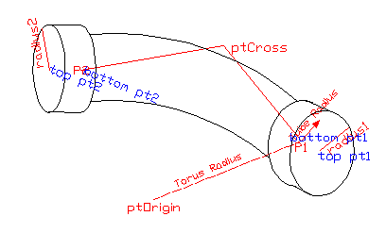
<ELBO>
TYPE2(SOCKET TYPE)
  <ELBO>,
  X1,Y1,Z1, //! P1
  X2,Y2,Z2, //! P2
  CROSS X,CROSS Y,CROSS Z,
  ORIGIN X,ORIGIN Y,ORIGIN Z,
  TORUS RADIUS,
  TUBE RADIUS,
  PIPE1 RADIUS,PIPE1 X1,PIPE1 Y1,PIPE1 Z1,PIPE1 X2,PIPE1 Y2,PIPE1 Z2,
  PIPE1 RADIUS,PIPE2 X1,PIPE2 Y1,PIPE2 Z1,PIPE2 X2,PIPE2 Y2,PIPE2 Z2

Slide 14
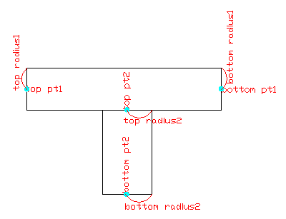
<TEE>
TYPE1(BUTT-WELDING TYPE)
  <TEE>,
  RADIUS1,
  X11,Y11,Z11, //! P1
  X12,Y12,Z12, //! P2
  RADIUS2,
  X21,Y21,Z21,
  X22,Y22,Z22

Slide 15
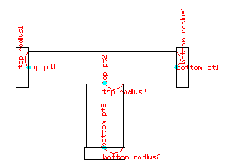
<TEE>
TYPE2(SOCKET TYPE)
  <TEE>,
  RADIUS1,
  X11,Y11,Z11, //! P1
  X12,Y12,Z12, //! P2
  RADIUS2,
  X21,Y21,Z21,
  X22,Y22,Z22,
  RADIUS3,
  X31,Y31,Z31, //! P1
  X32,Y32,Z32, //! P2
  RADIUS4,
  X41,Y41,Z41,
  X42,Y42,Z42,
  RADIUS5,
  X51,Y51,Z51,
  X52,Y52,Z52,

Slide 16
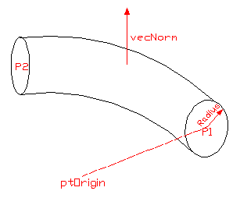
<CTOR>
<CTOR>,
X1,Y1,Z1, //! P1
X2,Y2,Z2, //! P2
ORIGIN X,ORIGIN Y,ORIGIN Z,
VecNorm dx,VecNorm dy,VecNorm dz,
Tube Radius

Slide 17
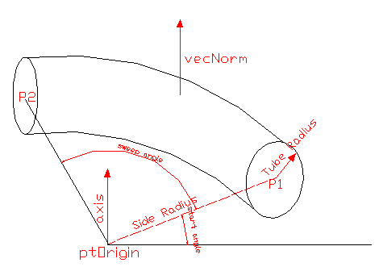
<TORS_EQP>
<TORS_EQP>,
ORIGIN X,ORIGIN Y,ORIGIN Z, //! ptOrigin
Outside Radius,
Tube Radius,
VecNorm dx,VecNorm dy,VecNorm dz,
Axis dx,Axis dy,Axis dz,
Start Angle, //! Start angle in degree
Sweep Angle //! Sweep angle in degree

Slide 18
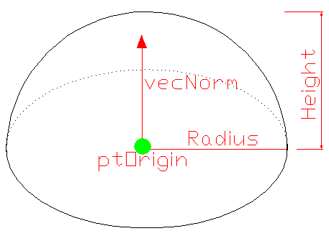
<DOME>
<DOME>,
RADIUS,
HEIGHT,
ORIGIN X,ORIGIN Y,ORIGIN Z,
VecNorm dx,VecNorm dy,VecNorm dz

Slide 19
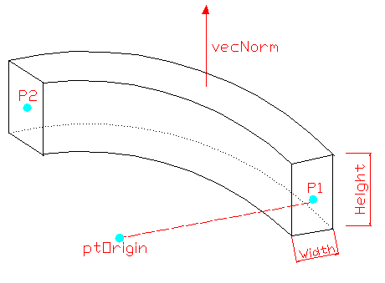
<RTOR>
<RTOR>,
X1,Y1,Z1, //! P1
X2,Y2,Z2, //! P2
ORIGIN X,ORIGIN Y,ORIGIN Z,
VecNorm dx,VecNorm dy,VecNorm dz,
WIDTH,
HEIGHT

Slide 20
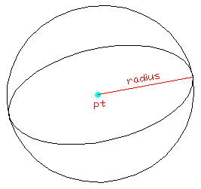
<SPHERE>
<RTOR>,
RADIUS,
ORIGIN X,ORIGIN Y,ORIGIN Z

Slide 21
<MESH>
<MESH>,
ROW,COLUMN,
X^Y^Z,…(number is ROW*COLUMN – 1)

Slide 22
MITER 형상 구현
P3
N-B
P2
N-A
P4
N-B
P1
N-A
예제) 4개의 중점을 가지는 MITER
P1-P2-P3로 이루어지는 평면을 P-A,
P2-P3-P4로 이루어지는 평면을 P-B라고 하자
P-A , P-B의 Normal Vector를 구할 수 있다.(N-A,N-B)
P2,P3,P4에서 접합 평면을 구한다.
P1에서 시작하여 평면과 직선의 교점을 구하는 방식으로
MITER를 이루는 점들을 구한다.

